Slide 1
Tram Light Project
1/9/2016

Slide 2
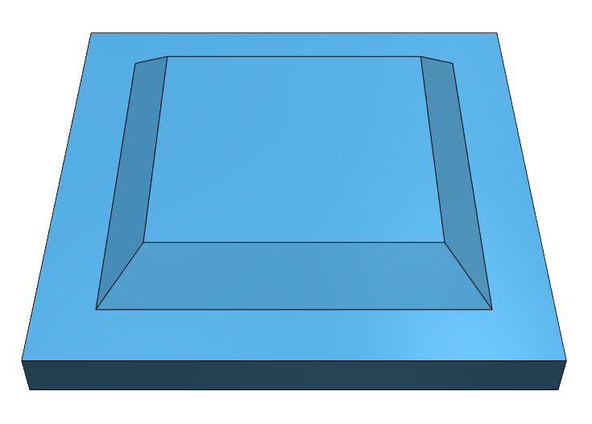


Slide 3
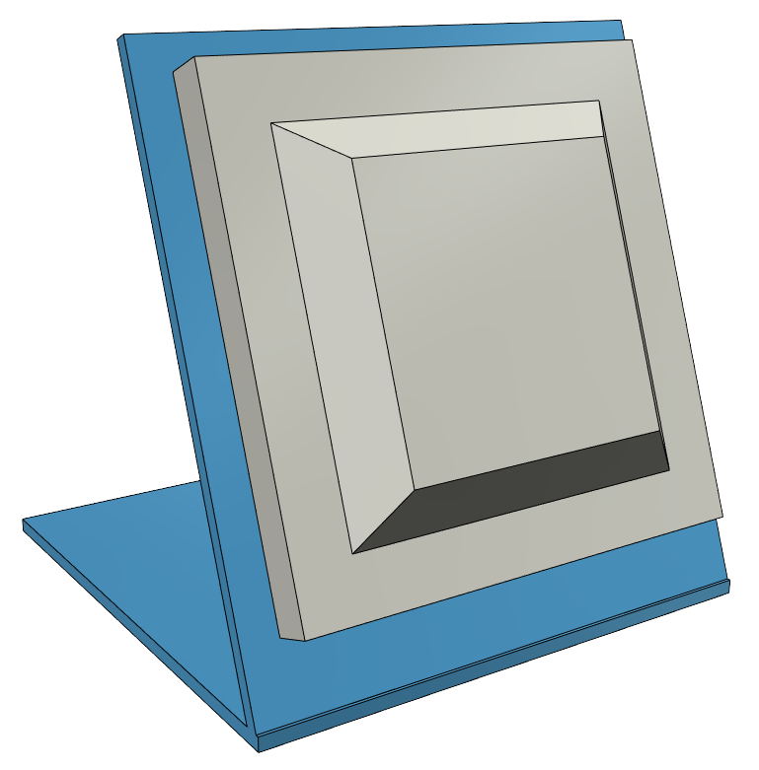

Slide 4
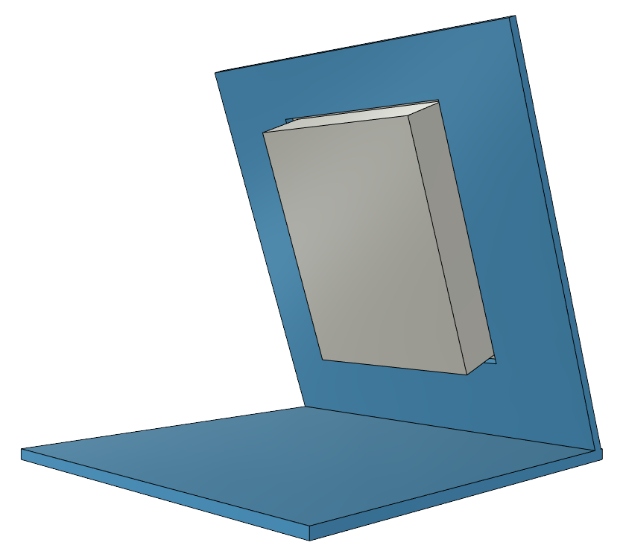

Slide 5


Slide 6
Still to Do
Is this idea mechanically sound?
How to form the angled joint?
Material?
Add mounting screw holes for attaching the light to the stand.
Make sure that the base plate is big enough to mount any electronics and the relay for graphene.

